Slide 1
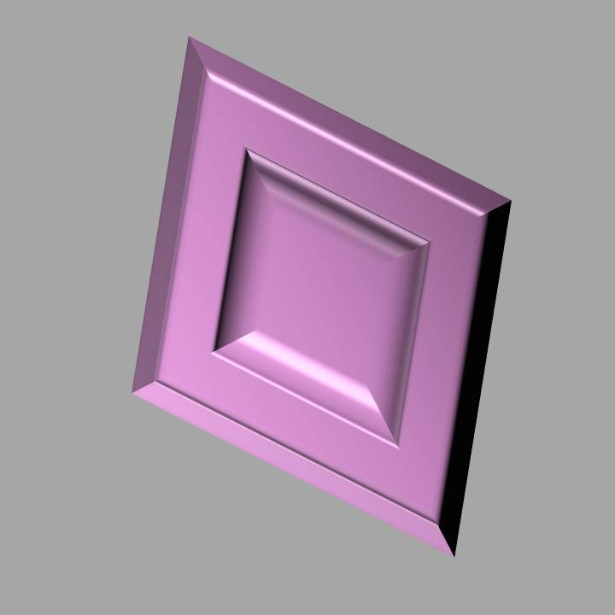


You will see 8 gems in total: With 4 of the gems you can win money With 4 of the gems you can lose money Your goal is to win coins with the gems predicting you can win money You want the neutral outcome with the gems predicting you can lose money
Instructions reminder

Slide 2
When a gem appears you can either 1) press left 2) press right 3) not press Each gem has one response that will give the best outcome most of the time, but not always
Instructions reminder

Slide 3
Important! You can only make a left or right response when the gem is on the screen Any button presses made after the gem disappears are not recorded and are marked as ‘not making a response’ Good luck!
Instructions reminder

